Slide 1

Pawtuckaway Lake Milfoil Status and Outlook Nottingham BOS Presentation October 6, 2025

Slide 2
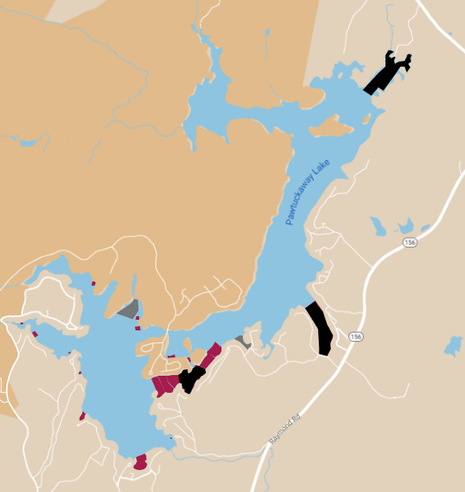
Milfoil Areas 2023
Black – Densest Areas Treated with ProcellaCOR
Gray- Less Dense Areas removed by hand pulling by professional DASH crew
Red- Least Dense Areas Searched and hand pulled by lake volunteer divers
Milfoil Status Map June 2023, color coded

Slide 3
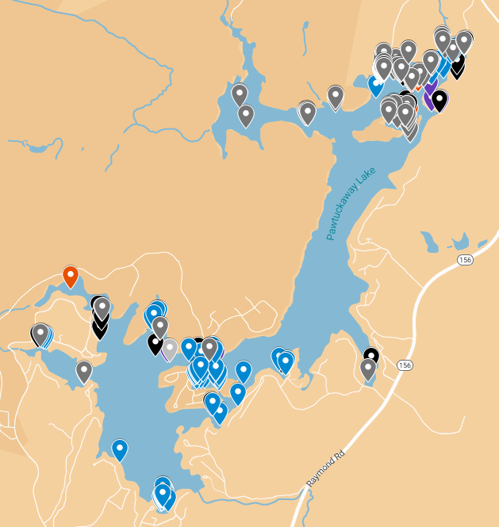
2025 Milfoil Locations

Slide 4
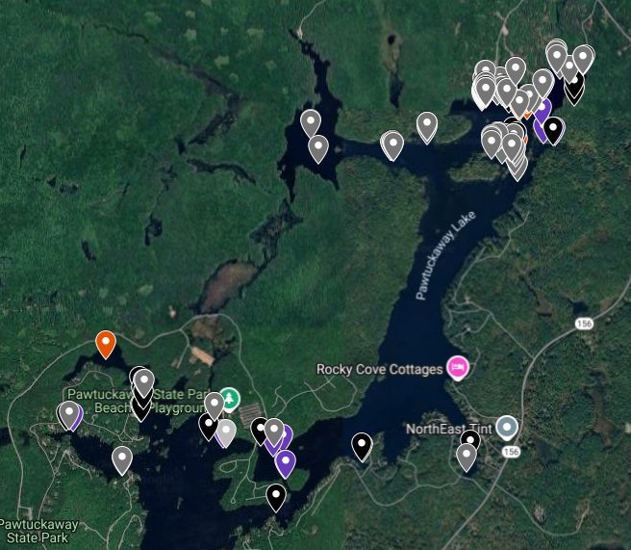
2025 Milfoil Not Yet Removed

Slide 5
Gallons of Milfoil Eliminated

Slide 6
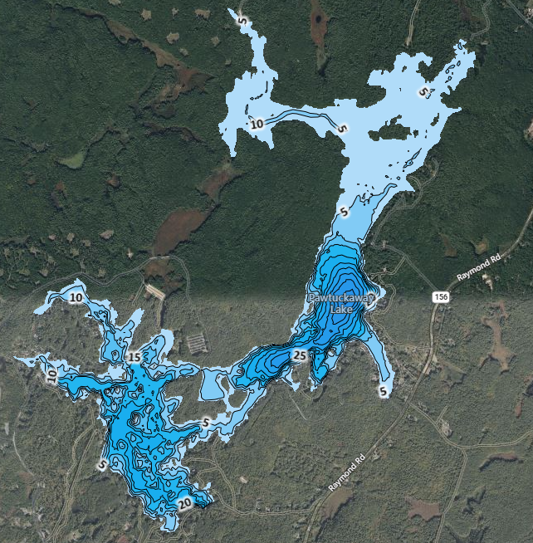
Pawtuckaway Bathymetric Map
Approx 60% of lake shallow enough for invasive growth.
Less than 12 feet deep.

Slide 7
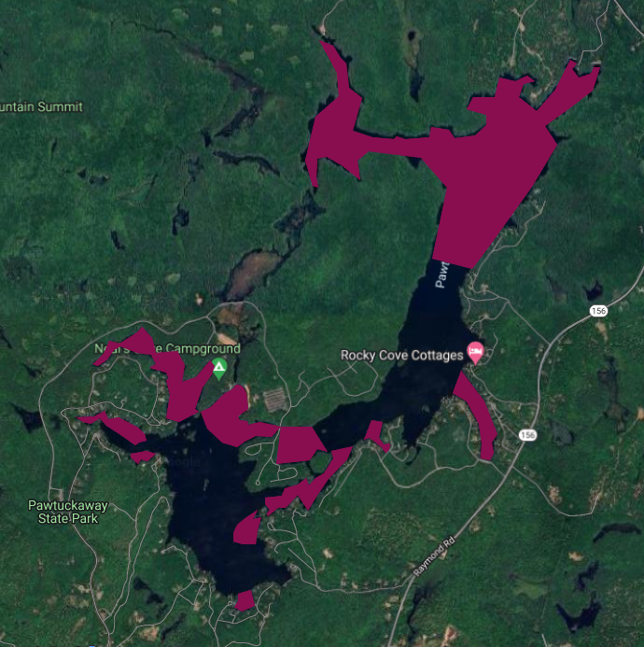
Lake Areas Shallow Enough for Aquatic Invasives
Town Beach
Public Boat Launch

Slide 8
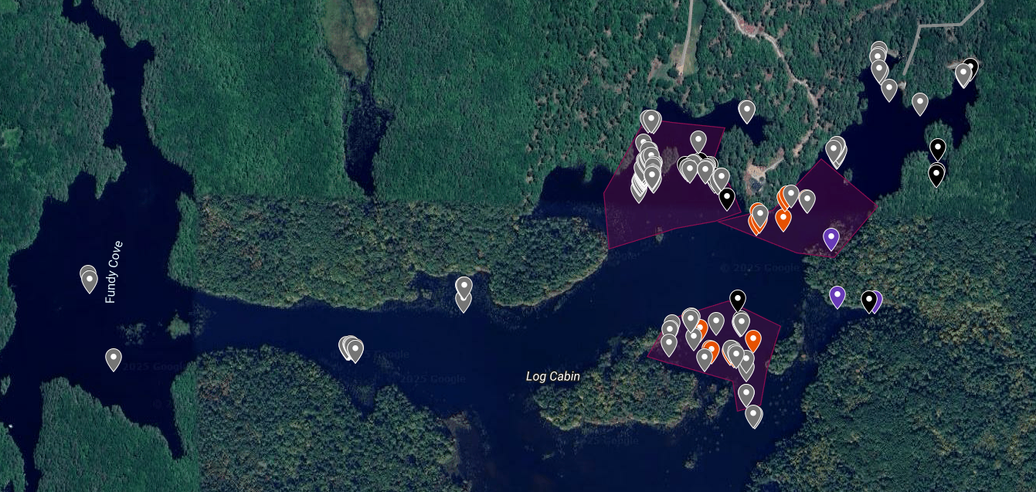
Northern Milfoil Infestation
Public Boat Launch
Heavily Infested Areas
Town Beach
65 Gal
0 Gal
163 Gal
This area is a major traffic channel for transient power boats entering the lake and popular with fishermen
Heavy weed cover, shallow water, 1-2’ silt make it extremely difficult for divers to remove milfoil successfully in this area

Slide 9
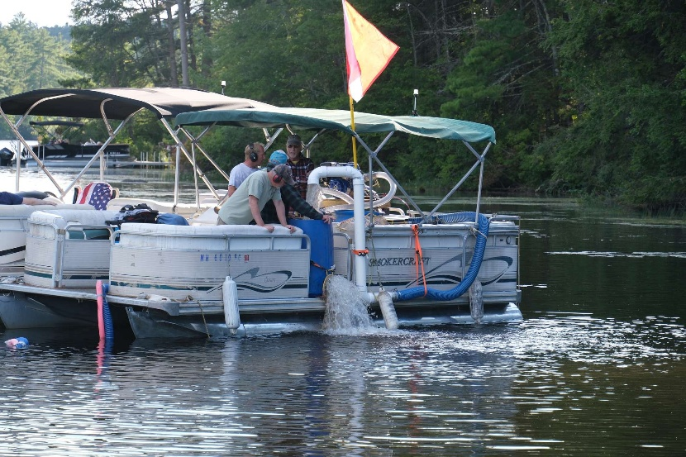
PLIA Activities
Volunteer Milfoil Team has continued to search, mark and remove milfoil to the limit of available resources
Over 720 volunteer hours this summer not including Weed Watcher time
PLIA has paid for some professional diver work to remove milfoil beyond volunteer resource
Volunteer Weed Control Diver has spent hundreds of hours building a DASH boat to remove milfoil more productively with less regrowth
Many lake residents have donated to help defer the costs

Slide 10
2025 Summary
Highest total milfoil removed by divers
Significant amount of milfoil found in southern end of lake
Volunteer resources not totally sufficient for removal
Utilized some paid divers to do multiple area removals
Major new areas of milfoil found in Northern End of Lake (Fundy)
Whole northern end of lake at risk
Volunteer resource not capable of fully surveying or removal
Without significant investment in paid divers or ProcellaCOR treatment, northern end of lake will be extensively covered with milfoil within two to three years

Slide 11
Action Plan
Southern End of Lake
Continue to use volunteers to locate and remove milfoil
Northern End of Lake
Need outside assistance to help control extensive spread of milfoil
Volunteer help not sufficient for current and anticipated milfoil demands
Meeting with NH DES in October to discuss strategy
Potential Funding Sources
NH DES Grant (application submitted)
Nottingham Invasive Species Fund
PLIA
Lamprey River Advisory Committee (applying for grant)
NH State Parks or other NH Gov Entities

Slide 12
Cost Estimate (tentative)
Assumptions
~50 acres at the northern end of the lake will need treatment
DES will determine that ProcellaCOR is the preferred remedy
We obtain a grant from DES (max 50% of actual cost)
Total Cost
~$50K (~$1000 per acre treated)
Potential Funding
NH DES,
$0-$25K (depends on demand for funds and budget)
Nottingham Invasive Species Funds
$15K
PLIA
$10K
Other?
Lamprey River Advisory Committee (grant application underway)
NH State Park
Other NH Government Sources

